Slide 1

MPMA General Line Sector
Sales Statistics for 2nd half 2019
Holiday Inn Hotel, Hinckley Road, Coventry
Wednesday 11 March 2020

Slide 2
Sample group up to 2nd half 2019
Afon Tinplate (now part of Tinmasters)
Ardagh Group Aerosols - not currently included
Ardagh Group (Norwich) - not currently included
ASA UK (formerly Central Tin Containers)
Crown Speciality Packaging
Cyril Luff Metal Decorators (estimated)
Emballator - not currently included
Huber Packaging
JKP Tins
Massilly (estimated)
Nepak (formerly Bericap UK)
RLM Packaging
Roberts Metal Packaging
Surecan
Tinmasters (formerly Caldicot Metal Decorating)
Tinware Direct
UCP
William Say and Co

Slide 3
Firms estimated
Guala Closures
James Briggs (up to December 2012 only)
KTC (formerly Packaging R Us)
McVitie
Macbey Metal Packaging (formerly Metal Closures Huddersfield)
Merseycan
Westmill Foods
Tate & Lyle (now ASR)
United Aerosol Manufacturers (UAM)

Slide 4


Sales by sector
Closures
Aerosols
Drums up to 25 litres
3 piece cans
Paint & woodcare
Industrial
Food + other
Slip lid cans
Narrow aperture
2 piece cans
Other packaging products, trays & components
Total

Slide 5
Sales of cans only
2014
Year to H2 2019
223m cans (2 and 3 piece only).
110m cans (2 and 3 piece only).

Slide 6
Key Points for 2nd Half 2019
2nd half 2019 showed some growth in total UK sales but all due to higher closures
Closures up 4.2% in H2 2019
Container sales fell -8.8% in H2 2019
Packaging products, trays & components -1.5% in H2 2019
Lower container sales in most areas apart from food up very slightly In H2 2019
Annual data for containers -2% for 2019 as a whole.
 | % change in 2nd half 2019
Closures | +4.2%
Containers | -8.8%
Other packaging products | -1.5%
Total UK sales | +2.2%

Slide 7
UK Sales of Closures
% change on the same period last year
Moving-annual-total in millions of units
% change (bars)
MAT for 2019 +3.4%
MAT = moving-annual-total.

Slide 8
UK Sales of Containers
% change on the same period last year
Moving-annual-total in millions of units
% change (bars)
MAT for 2019 -2.0%
All sales minus closures and other packaging products, trays & components.

Slide 9
UK Sales of Other Packaging Products
% change on the same period last year
Moving-annual-total in millions of units
% change (bars)
MAT 2019 +2.6%

Slide 10
Total UK and Exports Sales of Containers
(excluding sales of closures & other packaging products)
Moving-annual-total in millions of units
% change in MAT at end of Dec 2019
Total sales -4.9%
UK sales -2.0%
Exports -15.9%

Slide 11
Please note all GDP forecasts made before recent Coronavirus outbreak

Slide 12
Please note all GDP forecasts made before recent Coronavirus outbreak

Slide 13
Please note all GDP forecasts made before recent Coronavirus outbreak
USA
Spain

Slide 15
Aerosol Sales
% change on the same period last year
Moving-annual-total in millions of units
% change (bars)
No MPMA data after 1st half 2015.

Slide 16
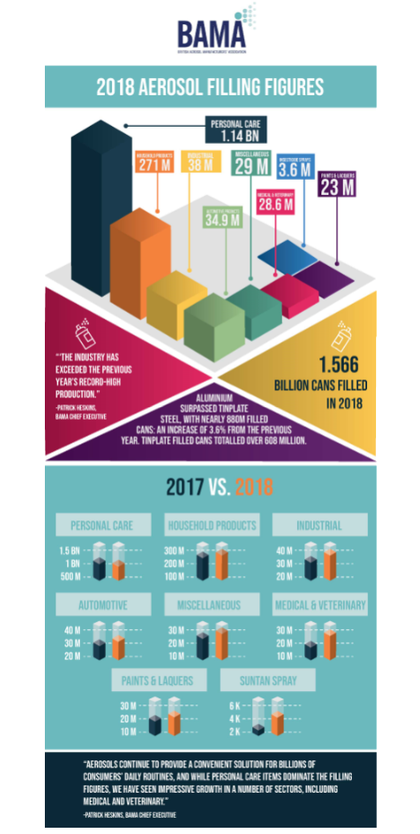
Fillings in 2018
Personal care the biggest (75%)
Air fresheners
(12%)
Auto & industrial
(5%)
Paint
(1%)
Total
+0.2%
-2%
+13%
-21%
+0.3%
Source: BAMA.
2019 data not yet available

Slide 17
Aerosol sales & aerosol fillings
Source: MPMA and BAMA
MPMA figures to end of June 2015 only.
BAMA sales +0.3% in 2018 following a 2% increase in 2017.
Tinplate -3% in 2018
Aluminium +4% in 2018
Remember the BAMA figures are for fillings.

Slide 18
New data to be available soon
Source: Kantar. Year to March each year 2018.

Slide 19
3 piece lever lid: Paint & Woodcare Sales
% change on the same period last year
Moving-annual-total in millions of units
% change (bars)
Paint Sales:
2016 +2%
2017 -2%
+1%
2019 +2%
No container data after 1st half 2015.

Slide 20
Can sales & paint sales
Source: MPMA and BCF
Paint litreage in 2019 +2%
Cans for paint & woodare
Woodcare litreage 2019 -2%

Slide 21
Paint and woodcare sales
2nd half 2019 -2%
2nd half 2019 -23%
Source: BCF.

Slide 22
Paint sales: Retail & Trade
2nd half 2019 -3%
2nd half 2019 -1%
Source: BCF.

Slide 26
% change on previous year
 |  |  |  |  | Housing
 | Retail Paint | Trade Paint | Total Paint |  | Transactions* | Starts*¹ | Completions*¹ | Construction in total*¹
2016 | 1.2 | 3.0 | 2.1 |  | 0.4 | 5.0 | -1.0 | 4.1
2017 | -5.8 | 0.8 | -2.4 |  | -1.2 | 5.0 | 14.0 | 7.1
2018 | 3.0 | -0.8 | 1.0 |  | -2.3 | 2.0 | 2.0 | 0.3
2019 | 2.0 | 1.0 | 1.5 |  | -6.0 | -1.0 | 2.0 | -0.3
Forecasts
2020 | -1.2 | -0.2 |  |  | - | 2.0 | -1.0 | 1.0
2021 | 0.5 | 0.8 |  |  | 1.5 | 1.0 | 0.0 | 1.4
2022 | -1.0 | 1.6 |  |  | 2.0
2023 | -1.0 | 1.8 |  |  | 2.5
* Oxford Economics | *¹ CPA

Slide 27
3 piece lever lid: Food & ‘others’ sales
% change on the same period last year
Moving-annual-total in millions of units
% change (bars)
Large decrease in 2nd half 2016 confirmed.
MAT for 2019 +0.2%

Slide 28
3 piece lever lid: Industrial sales
% change on the same period last year
10% of total units
estimated
Moving-annual-total in millions of units
% change (bars)
MAT for 2019 -6%

Slide 29
Narrow aperture containers sales
% change on the same period last year
Moving-annual-total in millions of units
% change (bars)
No container data after 1st half 2015.

Slide 30
3 piece slip lid can sales
% change on the same period last year
Moving-annual-total in millions of units
% change (bars)
MAT for 2019 -1.5%

Slide 31
New data to be available soon
This shows data to the end of March 2018 by value.

Slide 32
New data to be available soon
By value
By volume

Slide 33
2 piece cans

Slide 34
Total 2 piece cans sales
% change on the same period last year
Moving-annual-total in millions of units
% change (bars)
MAT for 2019 -5%

Slide 35
Other packaging products, trays & components sales
% change on the same period last year
Moving-annual-total in millions of units
% change (bars)
MAT for 2019 +3%

Slide 36
UK Sales by sector
 |  | 2017 1st | 2nd | 2018 1st | 2nd | 2019 1st | 2nd
Closures |  | +2% | -9% | -2% | -8% | +2% | +4%
3 piece cans lever lid | Paint & WC | - | - | - | - | - | -
 | Industrial | -4% | +59% | -12% | +4% | +11% | -20%
 | Food + other | +5% | +3% | +0.2% | +0.1% | - | +0.3%
 | Slip lid cans | -18% | -11% | -12% | -4% | +17% | -9%
 | Total | -10% | -5% | -8% | -2% | +11% | -8%
2 piece |  | -11% | -9% | +4% | +5% | +1% | -11%
Other packaging products |  | -0.4% | -2% | +6% | +4% | +7% | -2%
Total sales |  | +1% | -8% | -0.6% | -6% | +4% | +2.2%
After closures & other packaging products |  | -10% | -5% | -5% | -1% | +9% | -9%

Slide 37
Exports

Slide 38
Export Sales by sector
 | 2017 1st | 2nd | 2018 1st | 2nd | 2019 1st | 2nd
Closures | +6% | +4% | -6% | -30% | +4% | +39%
2 piece cans | -5% | +22% | -9% | -23% | -15% | -17%
Total sales | +5% | +6% | -7% | -30% | +2% | +35%

Slide 39
Closures Exports
% change on the same period last year
5% of total units
estimated
Moving-annual-total in millions of units
% change (bars)
MAT for 2019 +20%

Slide 40
Exports 2 piece cans sales
% change on the same period last year
Moving-annual-total in millions of units
% change (bars)
MAT for 2019 -16%

Slide 41
Employee numbers
% change on the same period last year
Total full time equivalent
% change (bars)
1,790 people in 2019
Including temporary employees as from 2008. Currently, these account for about 6% of all employees.

Slide 42
Key Points Summary for 2nd half 2019
A poor 2nd half 2019 for containers
But a good 1st half 2019 means annual sales not so bad
Container sales -8.8% in 2nd half 2019
Other packaging products -1.5%
Closures +4.2%
In annual terms:
Containers -2%
Other packaging products +3%
Closures +3%

Slide 43
Summary for Containers
3 piece industrial -20% in 2nd half 2019
Food & other sales unchanged +0.3%
3 piece slip lids -9%
2 piece cans -11%
Poor year for exports
Closures 20% but 2 piece cans -16%
Employee numbers down 8% in last year

Slide 44
Thank you

