Slide 1
MPMA CCA – 2020 Results
(Target Period 4)
5th August 2021
Siobhan Gibbons, Jacobs

Slide 2

Contents
CCA update
MPMA target & previous performance
2020 reporting timeline
Performance at 2020 (TP4 results)
  Breakdown of results
CCA Timeline – next 12 months
Questions?

Slide 3
MPMA Targets
Base Year (BY) = October 2007 to September 2008

Slide 4
Sector Performance – Target Period 1, 2 & 3
Overall sector performance for MPMA at TP1, TP2 & TP3:
2013-2014
2015-2016
2017-2018
2019-2020

Slide 5
CCA Reporting and Admin Timeline
31st December
End of Target Period 4
1st May
2020 reporting deadline
1st July
Deadline for TP4 buy-out payments
31st December
Half-way through Target Period 5
2021
January
February
March
April
May
June
July
August
September
October
November
December
Jan-April
2020 reporting
July - September
Summer variation window
November
CCA Contact Check
Today

Slide 6
Sector Performance – Target Period 4
2013-2014
2015-2016
2017-2018
2019-2020
?
Results have not yet been confirmed, reported and published by the EA
Forecast Results – to be confirmed

Slide 7
Sector Performance – Target Period 4

Slide 8
Sector Performance – Target Period 4

Slide 9
Sector Performance – Target Period 4

Slide 10
CCA timeline: next 12 months
Today
July - September
Summer variation window
November
CCA Contact Check
31st December
Halfway through Target Period 5
2021
2022
June
July
August
September
October
November
December
January
February
March
April
May
1st July
TP4 Buy-out payments due
Jan-April
2021 reporting (TP5)

Slide 11

Any Questions?

Slide 12
MPMA CCA – Carbon policy update
5th August 2021
Claire Chaffer, Jacobs

Slide 13
Agenda
CCA Extension (TP5)
CCA post 2025
Industrial decarbonisation

Slide 14
CCA Extension
Target Period 5 (TP5)

Slide 15
2 Year CCA Extension
Timescales
Target Period 5 (TP5) Jan 2021 to Dec 2022
CCL discount to 31 March 2025
TP5 reporting Feb 2023
TP5 target for MPMA:
MPMA accepted 6.670% novem carbon efficiency target on 2018 BY
On track to beat target
Strong MPMA energy efficiency improvement 4.8%, 2018 to 2019 (SCC)
Maintain energy efficiency momentum
Notes:
Target confirmed by BEIS end of December 2020

Slide 16
Impact of CCA extension changes
Change for TP5 | Impact of change
Buy-out fee now £18/tCO₂e (was £14/tCO₂e) | Significant 30% increase in buy-out costs
No surplus carry over into TP5 | Medium impact 1 TU used surplus for entire TP4 buy out. Another 7 met target with surplus (15 TUs)
Penalties use new £18/tCO₂e | Low impact Penalties are rare
CCL discount extended to Mar 2025 | Very significant Discount ~£3.8M PA 2021-2024 for MPMA
TP5 base year 2018 (was 2008) | Mixed More relevant BY / Harder for earlier movers
New entrants allowed | Positive impact 1 new entrant (Crown Packaging), now 16 TUs

Slide 17
Future of CCAs beyond 2025

Slide 18



CCA consultation update
Work has started on any future CCA scheme
CCA Consultation released this year if possible
Any future scheme will be considered in line with:
Industrial decarbonisation strategy
6th carbon budget for mid-2030 ambition
UK ETS review

Slide 19






BEIS feedback on CCA beyond 2025
Future CCA Features | What might change?
Eligibility criteria | Improved for better targeting and allow new EI sectors
CCA targets | Carbon reduction targets may be absolute, alongside energy efficiency Net-Zero 2050 pressure
Technologies recognised | Low-carbon technologies, renewable energy and on-site renewables, batteries and other energy storage
CCA carbon targets | Note interaction of grid decarbonisation
Longer payback measures | Government support may be needed
Scheme interaction | Work better with other schemes to reduce admin burden
NB Any future CCA beyond 2025 is not certain
Notes:
In the BEIS consultation response feedback on any longer-term CCA scheme beyond March 2025, the main points were:
CCA eligibility criteria could be improved to support better targeting;
Interest in carbon reduction targets, alongside energy efficiency targets;
Support for incorporating low-carbon technologies, renewable energy and on-site renewables, batteries and other energy storage in any future CCA scheme;
Concerns from respondents that some businesses would need help for longer payback measures;
Supporting industry in transition to net zero while maintaining competitiveness;
Potential for simplification of a future scheme alongside wider policy landscape.

Slide 20
Industrial Decarbonisation

Slide 21
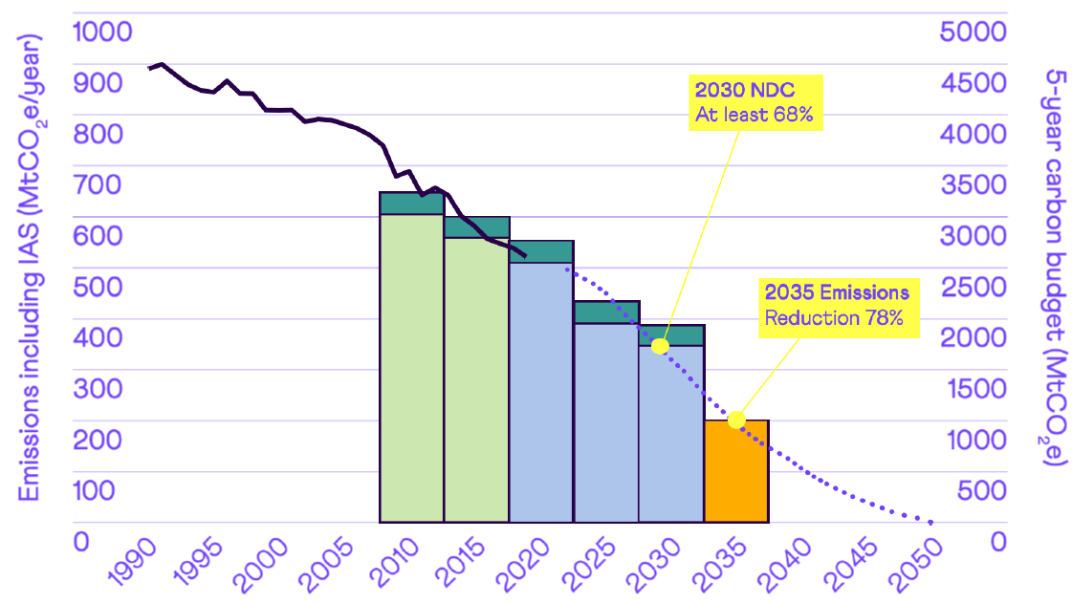
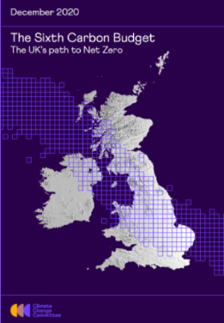
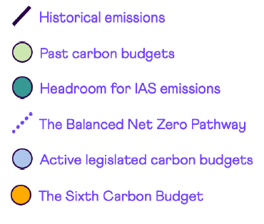
6th Carbon Budget 2033 - 2037
CCC released 6th Carbon Budget Recommendations Dec 2020
78% GHG reduction by 2035 on 1990 levels
First budget on net zero 2050 path
6th Carbon Budget Recommended Pathway
Source: Committee on Climate Change
Notes:
Sixth Carbon budget, which would achieve well over half of the required emissions reduction to 2050 in the next 15 years, and the supporting policies

Slide 22
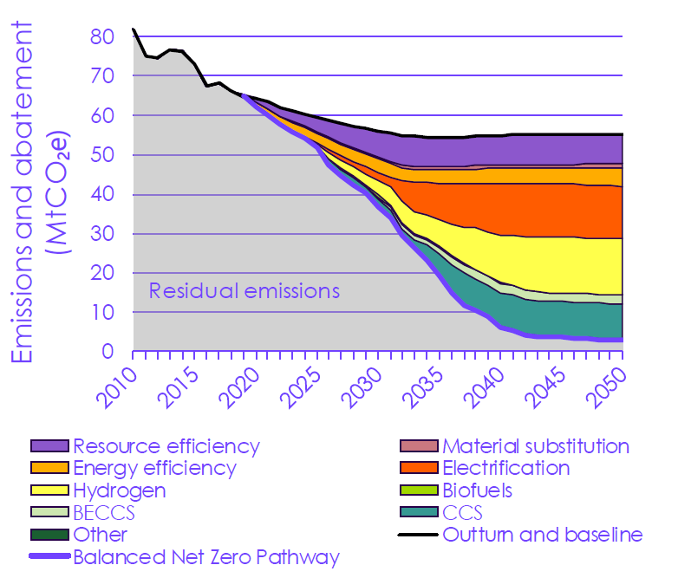
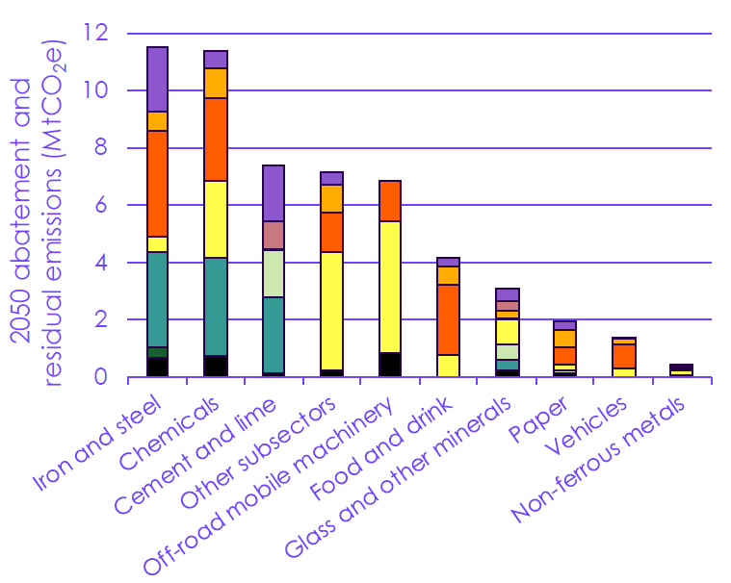

Industrial pathway to net zero 2050
Balanced Pathway for manufacturing and construction
Source: Committee on Climate Change

Slide 23
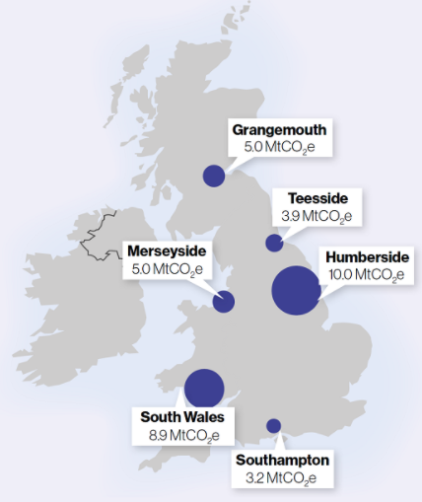
Industrial Decarbonisation Strategy
Examples of MPMA facilities
Envases (UK) Ltd - Port Talbot
Burton - Burton-On-Trent
Huber Packaging - Merseyside
Tinmasters Swansea Ltd - Swansea (nr Port talbot)
Crown Newcastle - 40m Teeside cluster
“Industrial Cluster Networks Scenario” proposals
Carbon intensive industrial clusters access to:
  CO₂ capture & storage
  piped hydrogen
Industrial sites within 25 km radius of CO₂ injection point:
  pipe networks for CO₂
Clusters located in a 25km radius of CO₂ injection points:
  Londonderry, Grangemouth, St Fergus, South Wales, Teesside, Humberside, Merseyside, Peak District, Southampton, Medway
Sites outside clusters are not able to decarbonise with:
  CCUS and Hydrogen
  bioenergy with carbon capture and storage
Next steps for MPMA – map major MPMA gas users in relation to clusters
Notes:
For example, industrial sites within 25km of Teesside are considered to be within an industrial cluster which has access to shared hydrogen transport and storage infrastructure and CO2 pipe networks.
Under the clusters scenario, sites that sit outside of these clusters are not able to decarbonise with CCUS, hydrogen or bioenergy with carbon capture and storage (BECCS).
If the industrial cluster route is chosen, for MPMA sites the access to both CO2 capture and to Hydrogen will be better if they are in an industrial cluster area.
Clusters are located in a 25km radius of CO2 injection points assumed at Londonderry, Grangemouth, St Fergus, South Wales, Teesside, Humberside, Merseyside, Peak District, Southampton and Medway. Sites that are not ports are considered points at which CO2 could be shipped or piped to a nearest port or offshore storage site.

Slide 24
Indicative roadmap to net zero UK industry
Emissions about 70 megatons CO2
20 Terawatt hours fossil fuels replaced with low carbon alterantives
Emissions down by two thirds from 2018
Emissions down by at least 90% from 2018
Call for evidence on low carbon industrial products
Net zero aligned ETS
Voluntary product standards
(potential)
Two more carbon
capture clusters
Zero avoidable waste of materials
2021
2023
2025
2030
2035
2040
2050
Industrial clusters receive funding for engineering studies
Companies receive funding for industrial energy transformation
Two carbon capture clusters
Around 3 megatons CO2
captured
Word’s first net zero cluster
Design of UK ETS reviewed to align with net zero
Locations of first carbon capture projects chosen
Almost no fossil fuels unless with capture
KEY:
Policy actions
Changes
Source: BEIS Industrial Decarbonisation Strategy

Slide 25

Decarbonising Food and Drink
FDF vision for a net zero Food and Drink industry by 2040
Net Zero Roadmap at drafting phase, publish in November 2021
~50 page ‘handbook’ to help businesses act on net zero, inlcudes:
Examples of leadership for effective low carbon transition:
F&D emissions profile for each stage of value chain
Packaging section: technology; sector initiatives; policy; potential
Call to action: sector initiatives supporting carbon reduction
Designing products
with less packaging
Equipped to compete
on tenders with
climate credentials
Engage suppliers on climate performance & decarbonisation

Slide 26
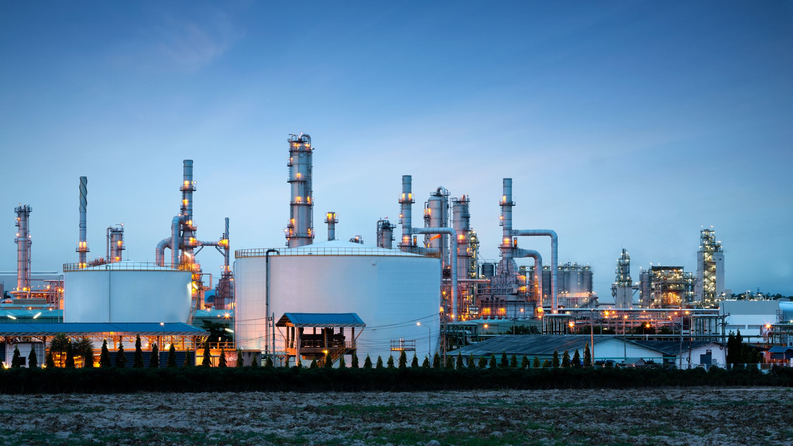


Update on UK ETS and Possible Border Tax
UK Emissions Trading Scheme
  UK ETS was £44/t CO₂ in first auction
  EU ETS was £47.50/t in May
  EU ETS sharp price rise (Governments)
  Exploring expanding scope of the UK ETS
  CCA sectors not affected in short to medium term
Carbon Border Tax suggested in run up to COP26
  Completely separate to the UK ETS
  Could force Britain’s trading partners to pay additional levies
  Levy could depend on carbon impact of their exports to the UK
  EU already has plans in place to set up a carbon border tax

Slide 27




ESOS Consultation
Consultation on ESOS Phase 3 launched this week:
  Look at carbon as well as EE?
  Public disclosure of ESOS data and action plans?
  Include medium sized companies?
  Mandatory to implement low payback recommendations?
Next non-ETS Measures WG in September on consultation
Notes:
For example, industrial sites within 25km of Teesside are considered to be within an industrial cluster which has access to shared hydrogen transport and storage infrastructure and CO2 pipe networks.

Slide 28
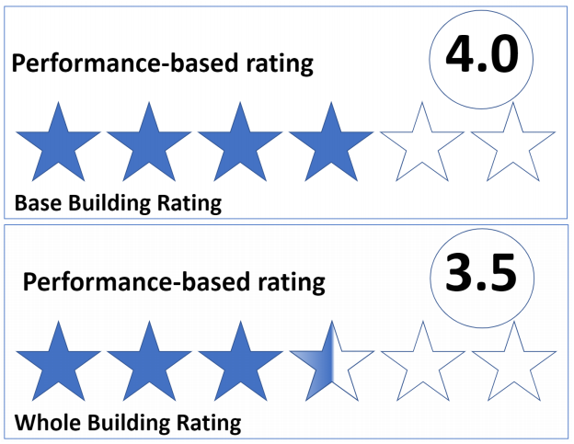
Performance Framework: Industrial & Commercial Buildings
Consultation proposes:
Rating energy & carbon performance of commercial & industrial buildings
Buildings above 1,000m² (England & Wales)
Annual energy & carbon performance ratings published on-line
Benchmarks established in collaboration with industry
Rating must improve over time
Submit metered energy use data every year to the ratings administrator
Uncertain timescale for industrial buildings e.g. 2025

Slide 29
Conclusions

Slide 30
Summary
Entering a new policy phase for decarbonising industry:
  Demand to ramp up energy efficiency and move away from gas
  Absolute carbon savings pressure under net zero
  Any future CCA will be challenging
Business to factor in short- and medium-term planning
More transparency in future
Notes:
We are about to enter a new policy phase that sees demands and pressure to drive energy efficiency ramp up substantially across the economy.
Businesses need to factor that into their short medium and long term planning.
Pressure from investors wanting to invest in green economy
Suppliers are under more scrutiny from major retailers, food companies and investors for low carbon initiatives
Need funding support for the energy efficiency investments from Government - IETF

Slide 31
CCA Helpline
Telephone: 0845 600 8122
Email: cclevy@jacobs.com
Website: www.cclevy.com

