Slide 1
COUNCIL & EXECUTIVE COMMITTEE MEETING
TO BE HELD ONLINE
ON WEDNESDAY 29TH APRIL 2020, COMMENCING AT 10.30AM

Slide 2
Agenda
1. APOLOGIES FOR ABSENCE
2. VERBAL ACCEPTANCE OF MPMA COMPETITION COMPLIANCE PROGRAMME
3. APPROVAL OF MINUTES OF LAST COUNCIL & EXECUTIVE COMMITTEE MEETING HELD ON 19TH NOVEMBER 2019
4. COVID-19 / CURRENT BUSINESS SITUATION
5. UPDATE ARTICLES OF ASSOCIATION
6. ASSOCIATION PERSONNEL UPDATE
7. REVIEW OF ACTIVITIES:
Regulatory Affairs
BREXIT
Scottish DRS
DRS, EPR, Mandatory Labelling & Standardisation of Collections
PRN scheme
Plastics Tax
Food Contact- BPA/CYCLO-DI-BADGE/TITANIUM DIOXIDE
CCA update
PR & Events
Activity including Canned Food UK
Annual Dinner
Environment
  Bref STS
  Chromium 6
  REACH
General Line
  Statistics
  Surfex
Aerosols
Beverage
8. REVIEW OF OFFICERS, COUNCILLORS, MEMBERSHIP
9. METAL PACKAGING EUROPE UPDATE
10. INTERFACE WITH OTHER UK ORGANISATIONS
  Metal Matters
11. FINANCE
  Year end 31 December 2019
  Year to date
12. ANY OTHER BUSINESS
13. DATE & VENUE OF NEXT MEETING
Notes:
Apologies for Absence Jason
Acceptance of MPMA Competition Compliance Programme Signature acceptance Jason
Approval of Minutes of Last Council & Executive Meeting Held on 16th May ’19 Jason
Update of Articles of Association Robert
Review of Activities Jason
Regulatory Affairs Robert
BREXIT
DRS
PRN Reform
OPRL
BPA / Cycle Di-Badge
CCA Update
Environment Robert
Bref STS
REACH
Post BREXIT
Chromium Free
General Line Robert/Debbie
Statistics
Surfex 2-3 June 2020
Aerosol Robert
Beverage Robert
PR & Events Debbie
Activity including Canned Food UK
2020 Programme Proposals
Annual Dinner
2019 feedback
The Future Robert/Debbie/discussion
Review of Councillors and Membership Debbie
Metal Packaging Europe Update Robert
Staffing/organisation/Strategy Robert
AGM & Open Space 2020 Debbie
Interface with Other UK Organisations Robert
Finance Robert/Debbie
Year to date
2020 budget
Any Other Business Jason

Slide 3
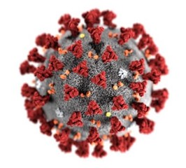
4. COVID-19 / Current Business Situation
Situation changing rapidly, strong debate between protecting lives and protecting economy
Debate being tempered by risks of easing the lock-down too soon and creating second peak
HMG continues to encourage all manufacturing to continue wherever possible while maintaining that staff who can work from home should work from home
Packaging identified as a key activity, especially where it supports the food supply or other essential products required to tackle COVID-19
MPMA endeavouring to keep members informed via daily bulletins with information being obtained from a range of sources including GOV.UK, BEIS, DEFRA, Make UK, Packaging Federation and the Food & Drink Federation
MPMA supporting members directly wherever possible when an issue is highlighted
BEIS continues to request information related to any problems or shortages being experienced by members
Notes:
As previously reported current Articles & Memorandum of Association date from 1978 and need revising. It was agreed the new Articles should:
Remove limit of 200 members
Broaden scope to include companies that make containers greater than 25 litres
Reduce of size of required quorum for a General Meeting
Inclusion of MPMA (CCL) Limited was discussed, but it was agreed to keep the organisations separate
Progress:
The original Articles and Memorandum of Association have been combined with the more recent MPMA Rules of Management and the resulting document modified to reflect the above requirements
This document will now be reviewed by MPMA’s lawyers prior to offering to the Council for approval

Slide 4
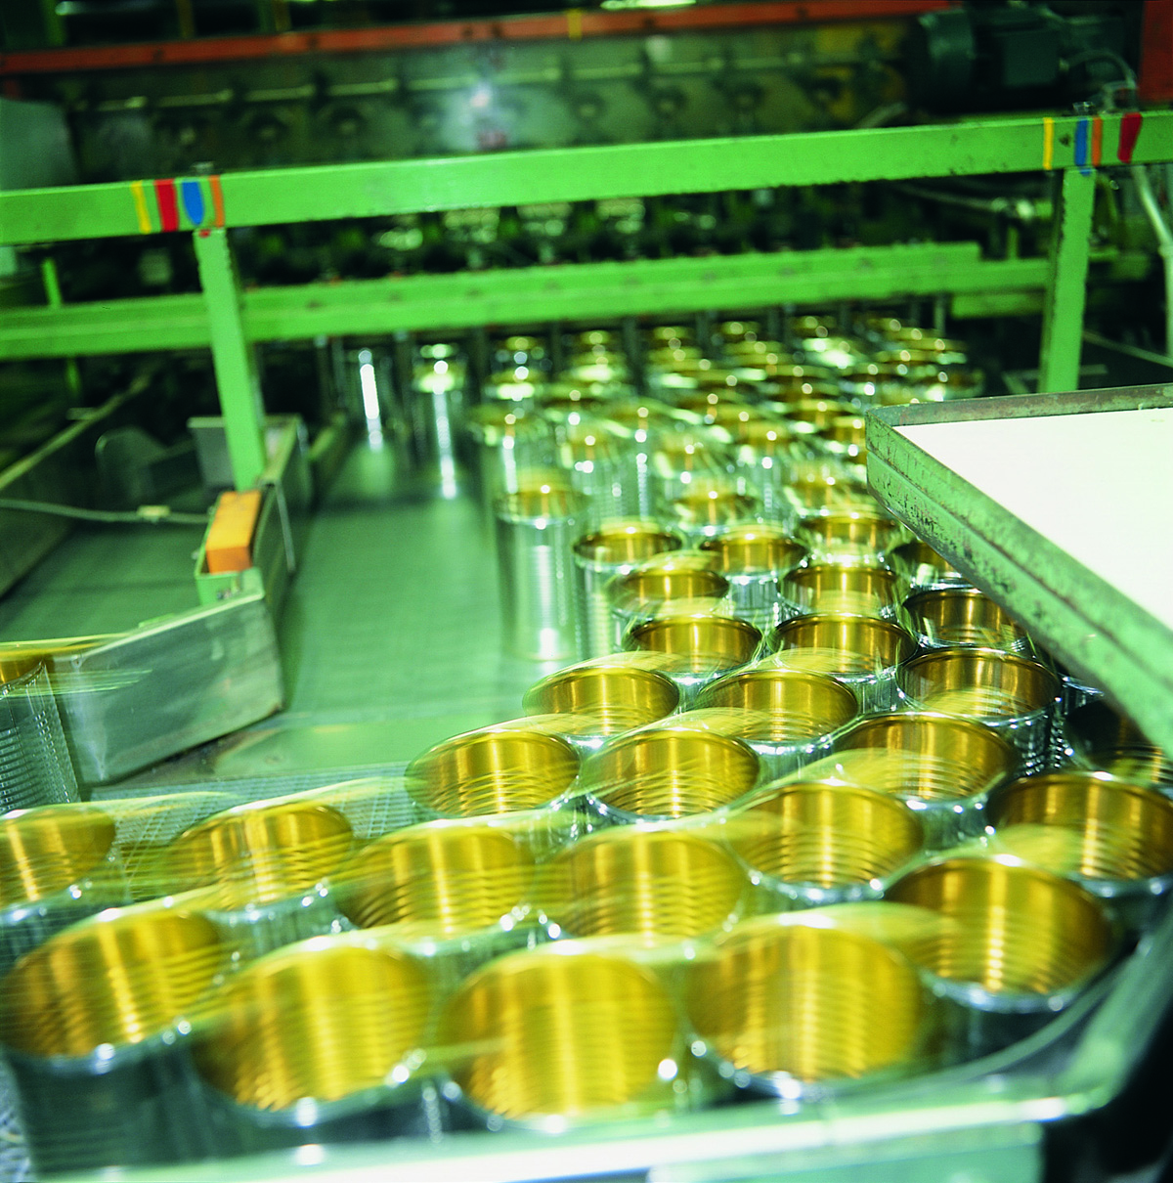
5. Update Articles of Association
Draft articles currently being worked through to ensure they correctly reflect how the Association operates before being sent to our lawyers for checking
They will then be issued to the Council for comment and approval before being put to the members for a vote
Notes:
As previously reported current Articles & Memorandum of Association date from 1978 and need revising. It was agreed the new Articles should:
Remove limit of 200 members
Broaden scope to include companies that make containers greater than 25 litres
Reduce of size of required quorum for a General Meeting
Inclusion of MPMA (CCL) Limited was discussed, but it was agreed to keep the organisations separate
Progress:
The original Articles and Memorandum of Association have been combined with the more recent MPMA Rules of Management and the resulting document modified to reflect the above requirements
This document will now be reviewed by MPMA’s lawyers prior to offering to the Council for approval

Slide 5

6. Association Personnel Update
As a consequence of increased technical and regulatory demands MPMA sought an experienced Technical and Regulatory Affairs Manager
Matt had already indicated a desire to reduce hours and become a consultant
Matt resigned end of 2019, starting as a consultant mid-Jan 2020
Contract 3 days/week for 3 months then 1 day/week for 3 months
After this period Matt will support MPMA if asked
Candidate search found an excellent individual in Stuart Falconer
Stuart was subsequently offered the positon which he accepted
Stuart, a chemist by qualification, started at Metal Box in Wantage in 1988 as a Metal Decorating Technologist and since then continued to work in the fields of coatings, labelling and foils, working for a range of companies in various quality and development roles
Stuart will start with the MPMA 1st May 2020
Notes:
As previously reported current Articles & Memorandum of Association date from 1978 and need revising. It was agreed the new Articles should:
Remove limit of 200 members
Broaden scope to include companies that make containers greater than 25 litres
Reduce of size of required quorum for a General Meeting
Inclusion of MPMA (CCL) Limited was discussed, but it was agreed to keep the organisations separate
Progress:
The original Articles and Memorandum of Association have been combined with the more recent MPMA Rules of Management and the resulting document modified to reflect the above requirements
This document will now be reviewed by MPMA’s lawyers prior to offering to the Council for approval

Slide 6
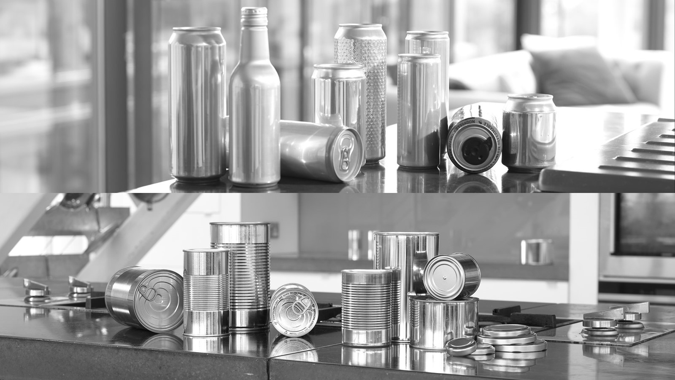
7. Review of Activities
Can Making
Notes:
Regulatory Affairs

Slide 7
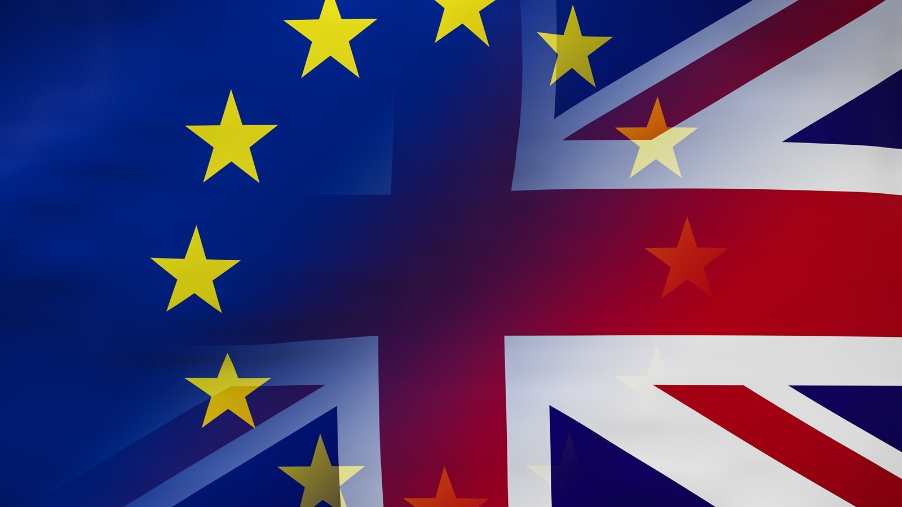
Brexit Update #1
UK left the EU on the 31st January 2020
3rd Feb 2020 Boris Johnson insisted that transition will be completed by the end of the year, and either:
  UK and EU will agree a deeper trading relationship on the lines of the free trade agreement EU has with Canada, or
  Relationship will be based simply on the Withdrawal Agreement deal agreed in October 2019, including the Protocol on Ireland / Northern Ireland.
  In either event the UK will be leaving the single market and the customs union at the end of this year and stakeholders should prepare for that reality
  BJ stated that “Future cooperation in other areas does not need to be managed through an international Treaty, still less through shared institutions”
  He highlighted several areas of policy that this would apply to, including environment
Notes:
.

Slide 8
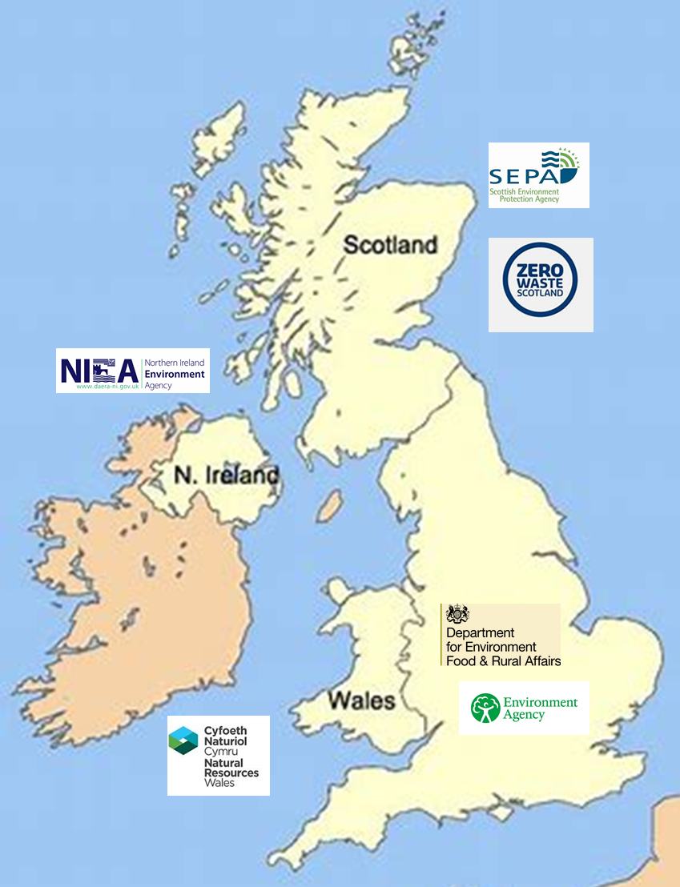
Brexit Update #2
HMG will initially adopt all EU legislation, transpose into UK law then modify as required
Areas such as REACH not included in BREXIT negotiations and so separate UK systems needed
Divergence from EU regulations looking highly likely
Several areas critical to metal packaging, such as Environment are a devolved activity within the UK.
Clear signs of struggles between devolved administrations and Westminster as to who is the most sustainable
Could lead to serious issues for industry, DRS in Scotland being an excellent example
Notes:
.

Slide 9

Brexit Latest
Conflicting views around the need or otherwise to extend transition period as a consequence of coronavirus
In a recent statement Downing Street indicated that the UK would refuse to extend the Brexit transition period, even if the EU requested it
A spokesman said any extension would keep the UK bound by EU rules when it instead "needs flexibility" to deal with coronavirus
On 15th April, UK and EU agreed to hold 3 further rounds of trade talks. Downing St added that an extension would "prolong the delay and uncertainty" around Brexit
As part of Make UK MPMA has been involved in a range of video meetings on coronavirus
Make UK current position is not to use the coronavirus as a reason to ask for an extension to the transition period as this approach by others has been badly received by Government
That said, Make UK agree that this would be the sensible option and know that the more pragmatic in Government are well aware of this, and they suspect strong debate on the subject behind the scenes
Notes:
.

Slide 10

DRS Scotland #1
Scottish Government have now published the Draft Scottish Statutory Instrument for their Deposit and Return Scheme. Key Points being:
Glass included
Deposit 20p per container despite all evidence suggesting this would be a mistake
Launch delayed to July 2022 (Scottish Government claim due to Coronavirus virus)
Timings are:
  1st Jan 2023 to 31st Dec 2023 70% recycling rate (total scheme packaging)
  1st Jan 2024 to 31st Dec 2024 80% recycling rate (total scheme packaging)
  1st Jan 2025 to 31st Dec 2025 (and each year thereafter) 90% recycling rate (total scheme packaging) and at least 85% recycling rate for each material specified
Notes:
Scotland still plan to include PET, glass, aluminium and steel beverage cans in their DRS
Glass industry continues to argue hard that they should not be included due in part to their 67% recycling rate
Point has been made to Scottish Government that by that definition beverage cans should also be excluded
However this situation is unlikely to change
Currently the deposit is still set at 20p per container although we continue to challenge this
MPMA attended Zero Waste Scotland’s Corporate Plan launch on the 12th September and took the opportunity to raise this issue again directly with the DRS team and ZWS’s CEO Iain Gulland
Whether anything can be changed is debatable but an offer of a meeting with ZWS and the Scottish Government was offered
.

Slide 11

DRS Scotland #2
Scottish decision to introduce a 20p per container deposit continues to be challenged
On 17th April a joint letter from Alupro, MPMA and Can Makers was sent to Scotland’s First Minister, Nicola Sturgeon.
Letter laid out objections to the 20p deposit per container and explained why it would not be in Scotland’s interest to proceed on this basis
Letter proposed a variable deposit related to pack volume as used in many other countries running a successful DRS
This is being followed up by further press releases and social media by both Alupro and MPMA
Notes:
Scotland still plan to include PET, glass, aluminium and steel beverage cans in their DRS
Glass industry continues to argue hard that they should not be included due in part to their 67% recycling rate
Point has been made to Scottish Government that by that definition beverage cans should also be excluded
However this situation is unlikely to change
Currently the deposit is still set at 20p per container although we continue to challenge this
MPMA attended Zero Waste Scotland’s Corporate Plan launch on the 12th September and took the opportunity to raise this issue again directly with the DRS team and ZWS’s CEO Iain Gulland
Whether anything can be changed is debatable but an offer of a meeting with ZWS and the Scottish Government was offered
.

Slide 12
DRS, EPR, Mandatory Labelling & Standardisation of Collections
2nd wave of consultations for DRS, EPR and Standardisation of Collection for England & Wales already delayed prior to the coronavirus, with current situation likely to push this out still further
As yet, launch date of 2023 for these pieces of legislation has not been changed
Concerns are that time available for consultation and review will be squeezed and rather like DRS in Scotland, the risk of unintended consequences increased
On a positive note, MPMA has secured a place on 2 important committees, the first being DEFRA’s Cross Cutting EPR, DRS, Consistency Meeting which covers the detail and introduction of these new areas of potential legislation
The second is the Environment Agencies Metal Industry Liaison meeting which from the Government side is chaired by the Environment Agency and attended by DEFRA, BEIS, SEPA, Natural Resources Wales and DAERA from Northern Ireland
Attendance of both these meetings is proving very useful
Notes:
As previously reported current Articles & Memorandum of Association date from 1978 and need revising. It was agreed the new Articles should:
Remove limit of 200 members
Broaden scope to include companies that make containers greater than 25 litres
Reduce of size of required quorum for a General Meeting
Inclusion of MPMA (CCL) Limited was discussed, but it was agreed to keep the organisations separate
Progress:
The original Articles and Memorandum of Association have been combined with the more recent MPMA Rules of Management and the resulting document modified to reflect the above requirements
This document will now be reviewed by MPMA’s lawyers prior to offering to the Council for approval

Slide 13
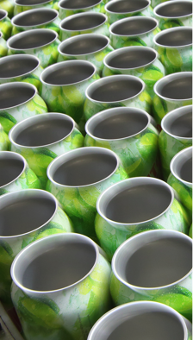
PRN Scheme
2019 difficult for plastics and aluminium. High plastic PRN prices were understandable, but not for aluminium which returned record recycling as reported by DEFRA
Several factors conspired to push the aluminium PRN price up, including companies registered to issue PRN’s exiting the scheme together with several reports of aluminium PRN’s being deliberately held back to push up the price
This has been reported to DEFRA by several organisations including MPMA
Data from Ecosurety earlier in the year suggested that 2020 will be equally hard for plastics, with only a modest respite for aluminium
That said, initial indications are that aluminium PRN prices are lower that initially predicted at around £100 - £220
This was before the coronavirus and there are concerns how potential changes in councils kerbside collections could affect all PRN prices
Fortunately, so far only 2 local authorities have stopped kerbside collections, with DEFRA writing to all of them to urge them to continue
Notes:
PRN prices remain high for Aluminium - PRN’s are currently trading at between £350 - £450
Steel PRN’s by comparison are trading around £30 - £40
Recent information from Ecosurety suggests that the aluminium price is high for a range of reasons:
Effects of the final UK conversions to aluminium beverage cans from steel now being felt (Britvic?). More material now needs to be processed, so more PRNs required
However, at the same time aluminium processing capacity has been lost from companies registered to issue PRNs
Greater proportion of aluminium packaging being processed by companies unable to issue PRNs
Companies are now trying to register but are unlikely to succeed until the end of the year/early 2020
Aluminium target will increase by 3% for 2020 & Ecosurety believe that PRN prices are likely to increase further before they drops back to a sensible level. Timescale currently unclear.
Companies currently trying to hedge by buying ahead

Slide 14
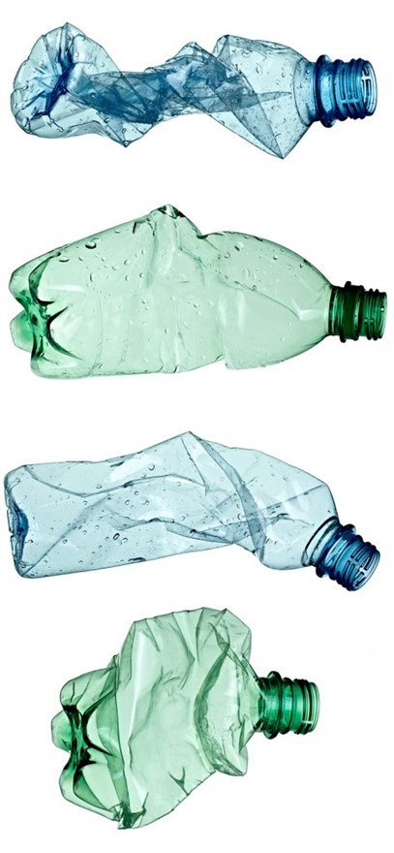
Plastics Tax
Confirmed in March Budget, Plastics Tax to be introduced in April 2022 at £200/tonne for plastic packaging with less than 30% recycled content. Will apply to both domestic production and imported plastic packaging
Tax will also cover imported filled plastic packaging where a minimum threshold of 10 tonnes of plastic packaging will be applied to ensure the smallest businesses are not disproportionately impacted
Launch of a further consultation on the details of the tax, including consideration of an exemption for certain types of medical packaging was also announced
It’s worth noting that that this new tax with be in addition plastics obligations under the PRN scheme
Several Trade Associations have expressed concern that the Treasury has still not agreed to delay the Plastics Tax Consultation which is currently set to finish in mid-May
Pressure being applied by the FDF, BPF, FPA and the PF amongst others but, as yet there has been no movement although apparently an imminent answer has been promised
Notes:
PRN prices remain high for Plastics - Plastic PRN’s are currently trading at between £375 - £450
Recent information from Ecosurety suggests that the plastics price is high for a range of reasons:
Effects being felt of Chinese Sword and the loss of other export markets
More plastic now needs to be processed domestically, more PRNs required, but far too little reprocessing capacity available
Situation exacerbated by increase in required recycling rate for plastic – this is only going to get worse into 2020 and beyond
Ecosurety believe that environmental costs around plastics will increase further still in 2023 under the new EPR system and its modulated fees
In fact Ecosurety are already working with clients to look at packaging material conversions away from the likely “problem materials” in preparation for 2023 and EPR
Ecosurety have been asked for calculation for metal and plastic paint cans

Slide 15
Food Contact - BPA
BPA Measure 2018/213 – applied since 6th September 2018
BPANI Coatings are currently less effective meaning:
  increased risk of coating integrity failure in the market place
  higher film weight & multiple passes = more material use, CO2 generation, material transport costs
  lower performance regarding staining and product release
The European Food Safety Authority (EFSA) to re-assess ‘Core Study’ by end 2020
Existing science (US Clarity Study) continues to support claim “BPA is safe”
Fully evaluated and authorised by the main risk assessment authorities (EU US Japan S. America etc.)
The issue remains that the BPA issue is driven by emotion and not science

Slide 16
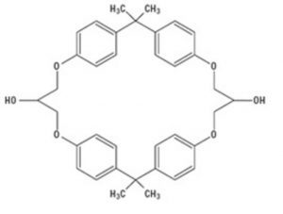
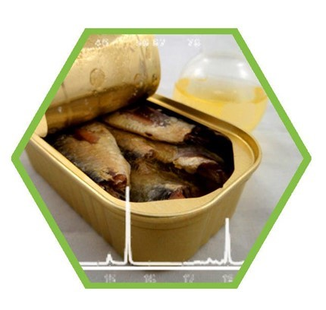
Food Contact - Cyclo Di-Badge
Cycle-di-Badge (CdB) is a non-intentionally added substance (NIAS) formed as a by-product during the manufacture of epoxy resins
Cyclo-di Badge is now considered potentially as harmful as BPA by certain organisations
Our sector experts are concerned that Cyclo-di Badge may pose more of a threat to epoxy coatings than BPA
German regional authority has been undertaking surveillance and is issuing warning letters
Part of the problem is that Cyclo-di Badge has yet to be fully toxicologically evaluated
As a consequence, and to gain advanced warning of a problem MPE, together with European coatings industry has set aside €700k funding to commission a toxicology study
This has now started and an interim report should be available by the end of 2020, with the full report due in 2021
Notes:
On the 28th July 2016 the German Federal Institute for Risk Assessment (BfR) published a statement regarding the migration of cyclo-di-BADGE (CdB) from food cans into oily foods
CdB is a non-intentionally added substance (NIAS) formed as a by-product during the manufacture of epoxy resins
CdB consists of bisphenol A (BPA, CAS 80-05-7) and bisphenol A diglycidyl ether (BADGE, CAS 1675-54-3)
Cyclo-di Badge is now considered potentially as harmful as BPA by certain organisations
Pressure exists from Germany and Switzerland to ban
MPE FCC is now focusing on CdB and MPE have finally approved their part of the funding on a €700k toxicology study
Our sector experts such as Richard Whitaker are concerned that CdB may pose far more of a threat to epoxy coatings than BPA

Slide 17
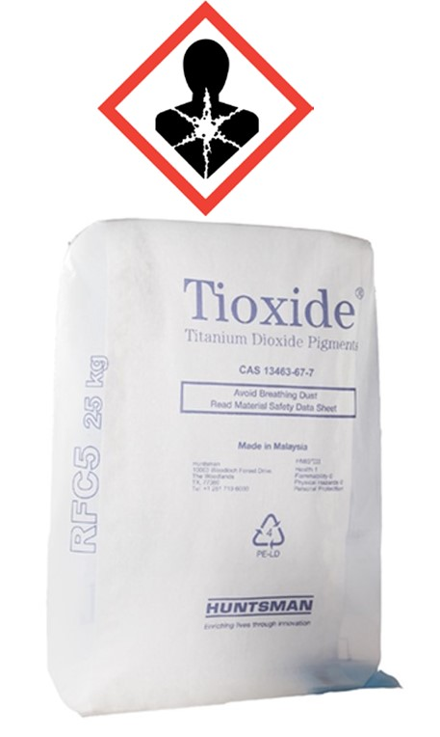
Food Contact - TiO₂
  18.02.20 - EU published a delegated regulation classifying titanium dioxide as a category 2 suspected carcinogen by inhalation under EU Regulation (EC) No 1272/2008 on classification, labelling and packaging (CLP) of substances and mixtures
  The paints, coatings and printing inks industries are the largest user globally of titanium dioxide
  Classification applies only for the powder form of the substance, not to liquid mixtures of paints, coatings or printing inks
  The ‘science’ behind classification, not based on chemistry, but results of ‘high exposure experiment’ on rats
  UK and EU regulations exist to protect workers from dust exposure
  Studies over many years have not found any correlation between workers exposed to titanium dioxide, and the risk of lung cancer

Slide 18

CCA Update
BEIS are going to extend the current CCA scheme by 2 years extending it until 31 March 2025. Key points:
Consultation on the new scheme just announced
Addition of a new Target Period TP5 (1 Jan 2021 to 31 Dec 2022)
Re-opening the CCA scheme to new entrant CCA applications, although approval is subject to the outcome of consultation
Proposed new baseline for TP5 is 2018 for all TUs
Final targets for TP5 will be agreed through a target negotiation process between BEIS and the sector associations – we may be asked to provide evidence on energy efficiency potential
Any banked surplus from TP1 to TP4 would not be allowed to be carried over into TP5
Buy-out Price: An increase in the buy-out price is proposed from £14/tCO2e to £18/tCO2e for TP5
Notes:
Climate Change Levy increased with effect from April 2019 but CCA rebate increased by same amount
When set-up and for a significant period afterwards, MPMA membership entitled companies to join MPMA CCA Ltd
Unfortunately, the current scheme is now no longer allowed to accept new members
Total annual cost savings/avoidance of additional cost to members estimated to be £7.2m to date
MPMA CCA Ltd scheme comfortably exceeded its Target Period 3 target of 8.333% reduction

Slide 19

CCA Update
Future CCA scheme: The consultation also seeks initial views on potential reforms were there to be a longer term future CCA scheme
The consultation deadline is June 11th 2020. Jacobs will be working with MPMA to draft a response to the CCA extension consultation.
The BEIS CCA Extension Consultation can be accessed via this link:
https://www.gov.uk/government/consultations/climate-change-agreements-scheme-extension-and-reforms-for-any-future-scheme
Notes:
Climate Change Levy increased with effect from April 2019 but CCA rebate increased by same amount
When set-up and for a significant period afterwards, MPMA membership entitled companies to join MPMA CCA Ltd
Unfortunately, the current scheme is now no longer allowed to accept new members
Total annual cost savings/avoidance of additional cost to members estimated to be £7.2m to date
MPMA CCA Ltd scheme comfortably exceeded its Target Period 3 target of 8.333% reduction

Slide 20
CCA Evaluation Report
BEIS has published the “Evaluation of the second Climate Change Agreements scheme” which will be used to inform any successor scheme
Some of the main points made in the evaluation include:
Strong support from existing participants for a future CCA-style policy
CCA has made a contribution to both energy efficiency and competitiveness objectives.
Evaluation suggests that the cost-effectiveness of the scheme could be improved if it targeted more closely sectors that are at risk from carbon leakage (i.e. that are both energy intensive and trade intensive)
Success of any future policy to support clean growth will be strongly influenced by the targeting of the scheme and the stringency of the targets set for participants
Slightly more than half of target units (TUs) achieved their targets without using buy-out or banked surplus in each target period
Notes:
Climate Change Levy increased with effect from April 2019 but CCA rebate increased by same amount
When set-up and for a significant period afterwards, MPMA membership entitled companies to join MPMA CCA Ltd
Unfortunately, the current scheme is now no longer allowed to accept new members
Total annual cost savings/avoidance of additional cost to members estimated to be £7.2m to date
MPMA CCA Ltd scheme comfortably exceeded its Target Period 3 target of 8.333% reduction

Slide 21
CCA Evaluation Report
The average level of underperformance was low and the level of overachievement of targets was greater.
The Evaluation informed the Government of the strengths of the scheme and highlighted opportunities to improve it
The CCA Evaluation Report can be accessed via this link:
https://www.gov.uk/government/publications/second-climate-change-agreements-scheme-evaluation
Notes:
Climate Change Levy increased with effect from April 2019 but CCA rebate increased by same amount
When set-up and for a significant period afterwards, MPMA membership entitled companies to join MPMA CCA Ltd
Unfortunately, the current scheme is now no longer allowed to accept new members
Total annual cost savings/avoidance of additional cost to members estimated to be £7.2m to date
MPMA CCA Ltd scheme comfortably exceeded its Target Period 3 target of 8.333% reduction

Slide 22
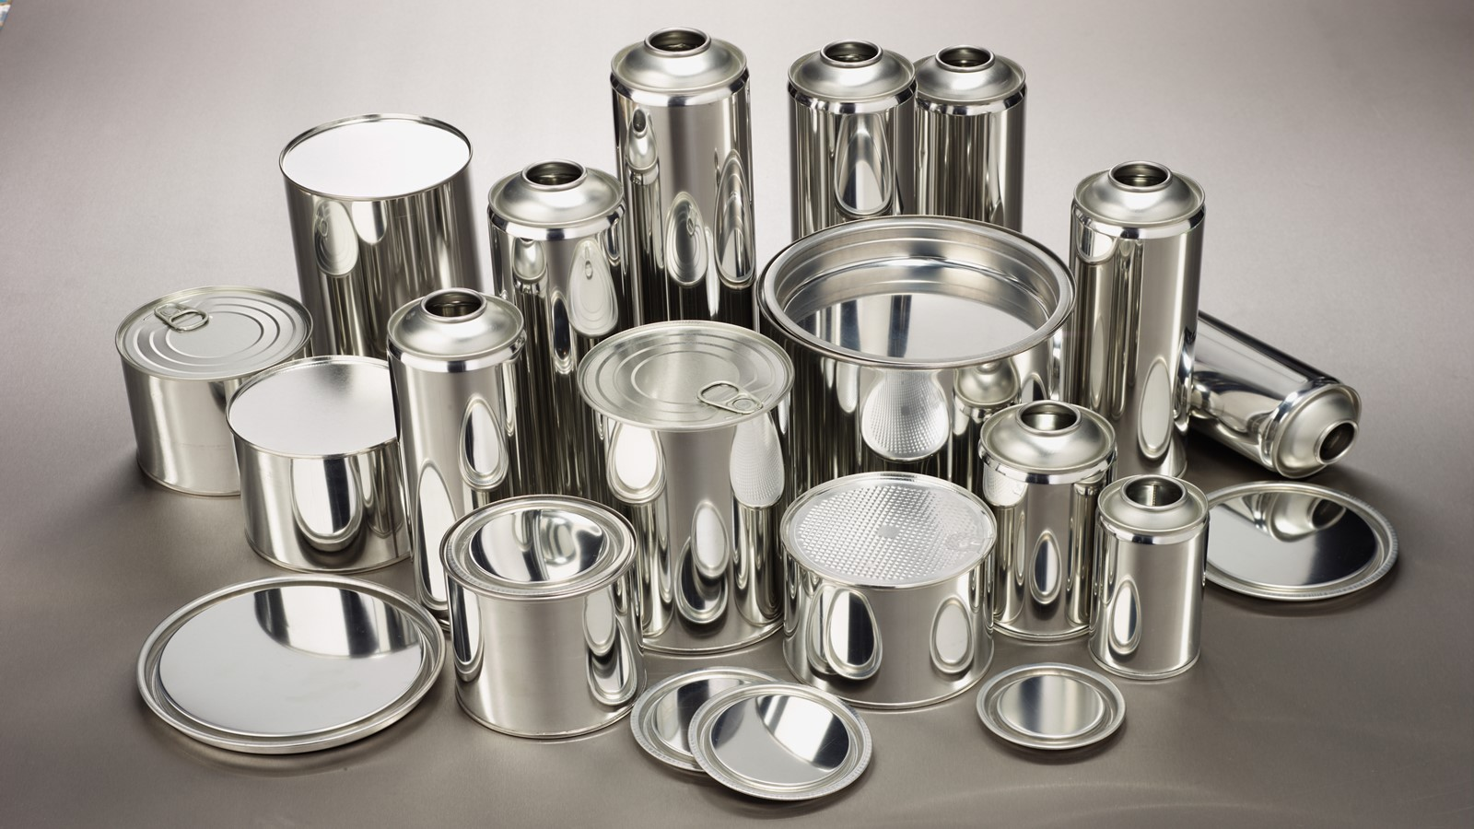
PR Activity

Slide 23
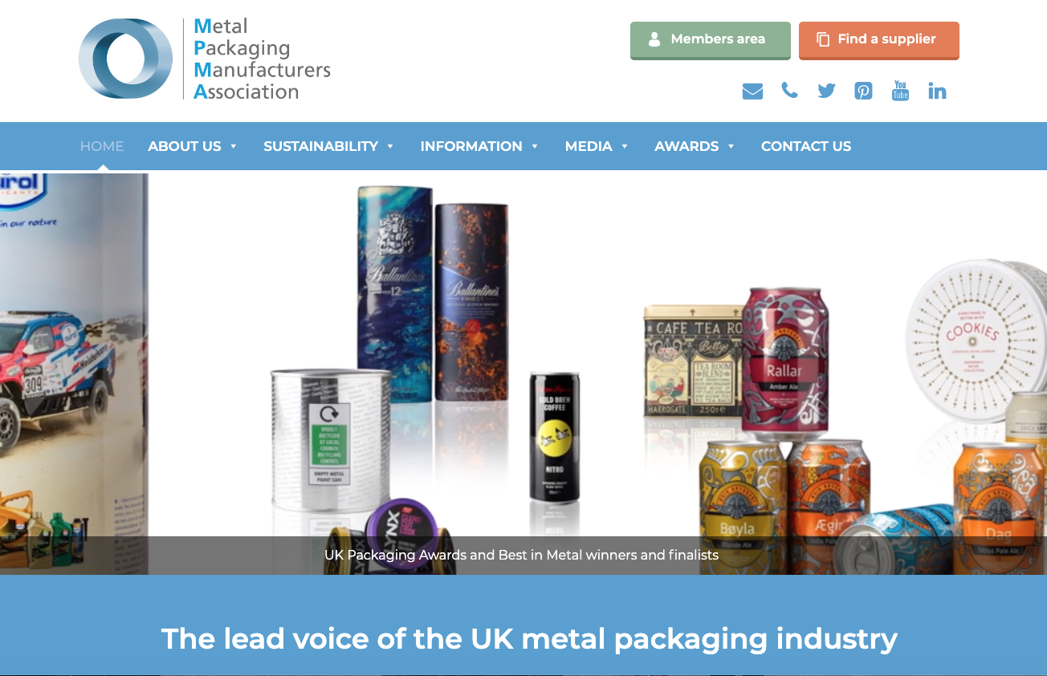
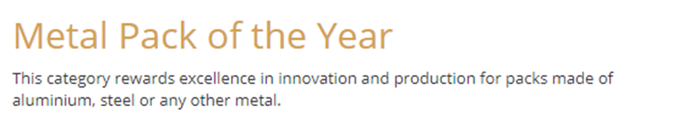
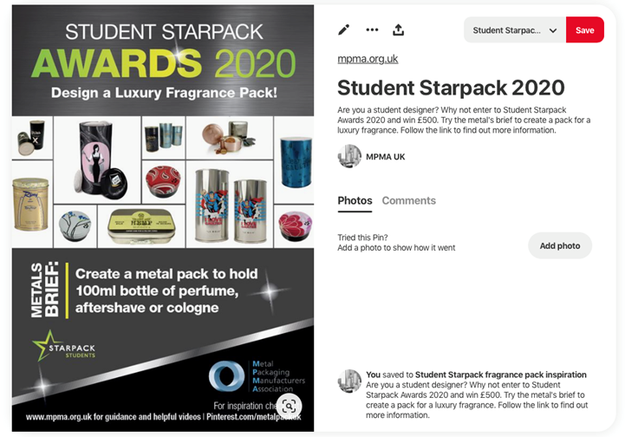

Website
UK Packaging Awards
Student Starpack
One Poll Research

Slide 24
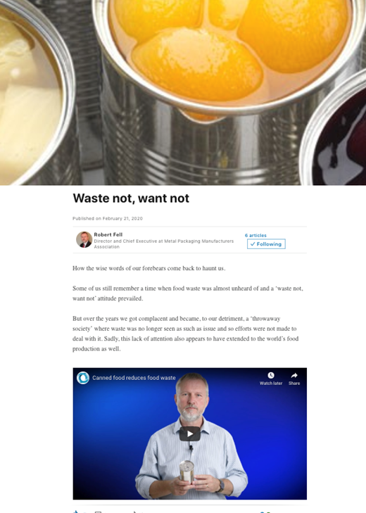

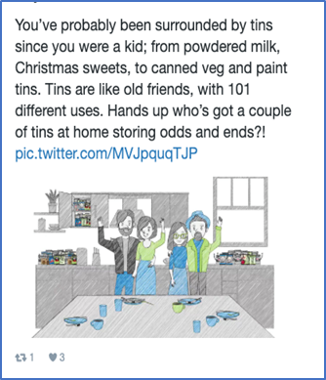
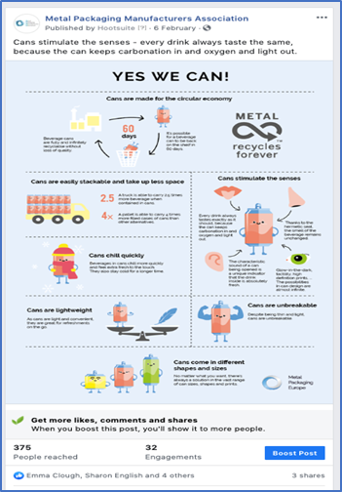
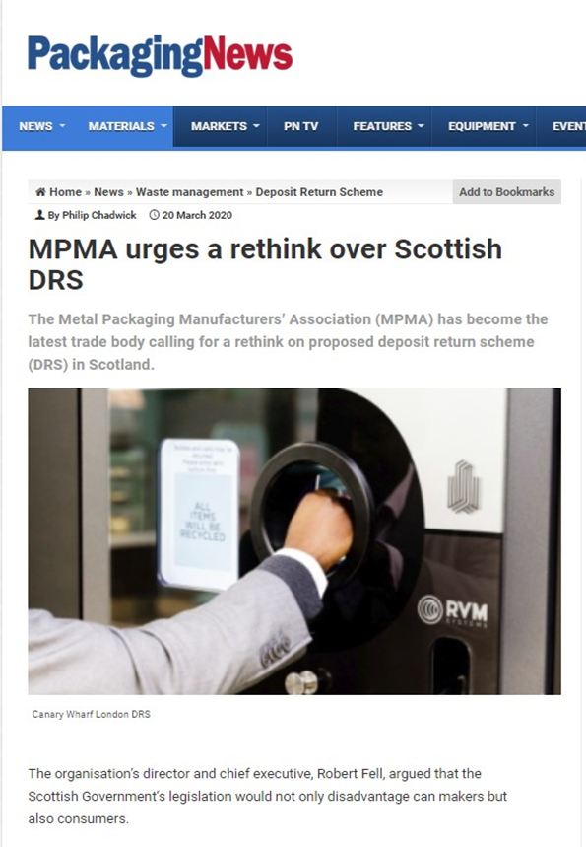
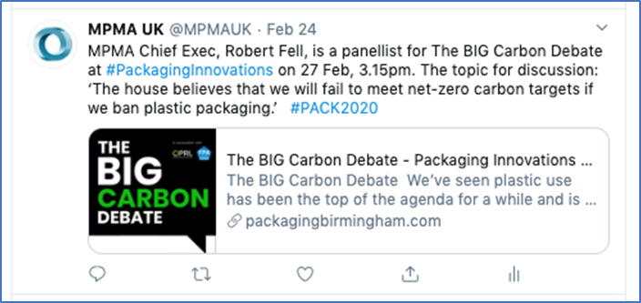
Blogs
Social Media
Media Relations
Packaging Innovations

Slide 25
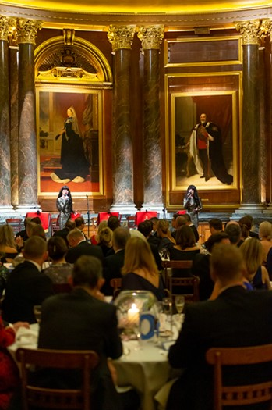

MPMA Annual Dinner
Friday 13th November 2020, Drapers’ Hall
Do we cancel for 2020 ?

Slide 26


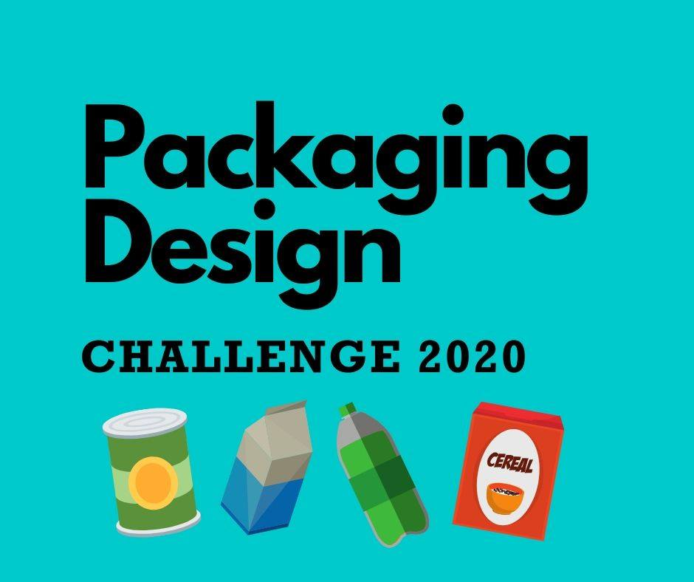
Canned Food UK
Jack Monroe new recipes
Lola Milne new campaign
Packaging Design Challenge

Slide 27


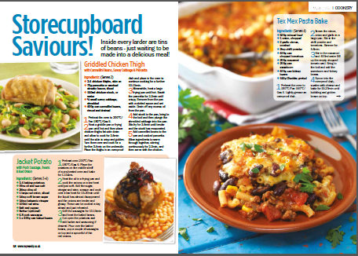
Canned Food UK
Social Media
Media Relations

Slide 28
So, what can be done?
Environment
Collaboration between Government & industry to remove the road blocks to increasing the use of secondary metals
Green Procurement: Even just asking your suppliers about recycled content, embedded carbon and eco-design will signal a new direction
Pull Mechanisms: Tax incentives for those using much higher recycled content
Eco-design: Creating a balance between “Design for manufacture” and “Design for re-use or recycling”
Research into better and more efficient ways of extracting clean single stream materials
Notes:
Environment

Slide 29
STS BREF
  Q4 2019, BAT conclusions published – 1,065 pages
  Parameters: Dust, Energy, Water Consumption, Emissions to Water, VOC (total, fugitive, in waste gases), NOX, CO
  The final version of the BAT submitted for vote of the IED Article 75 Committee Q1 2020.
  In the case of a positive opinion, it will be followed by the Commission's adoption and the publication in the Official Journal of the European Union, expected Q2 2020.
  Q1 2024, BAT conclusions apply to permits (existing installations and new) and applies to plants using >200 tonnes solvent per annum
  MPE BREF Group producing a BREF STS Guideline for the Metal Packaging Industry – expected end 2020

Slide 30
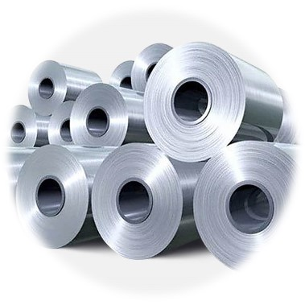
Chrome Free Passivation
Situation remains that APEAL members still legally able to use chromium VI compounds in their processes as there is no chromium VI on the surface of the final tinplate product
REACH authorisation process in place for CTAC (Chromium Trioxide) & CCST (Sodium Dichromate)
Current status for Wave 1 is that there is an extension of sunset date (4 years from approval publication)
For CCST, the extension is approved, and awaiting Commission publication
For CTAC, the extension has not yet been discussed as this has been delayed numerous times. It is however, an agenda item for the April 2020 meeting
WAVE 2: Current Status – to gain additional extension to allow for extended food pack-tests.
APEAL/MPE position papers prepared in readiness for Public consultation process – ongoing.
Notes:
Due to the new Commission coming into office, both AfAs were not discussed during the February meeting.
CCST: approved, but still awaiting for publication; when APEAL contacted the Commission it was not clear when exactly that would happen.
CTAC: vote scheduled to take place in February has been delayed to the 28-29 April meeting.
CCST approved (23 votes to 1)
• Review period starts from adoption date = 4 years until Q4 2023

Slide 31
You want to | You need to | By when
procure substances or mixtures (directly or in articles) from a UK-based entity | take no further action* *BEIS advised it would still be worth obtaining registration information from your supplier
procure substances or mixtures (directly or in articles) from an EU/EEA-based entity | EITHER notify HSE by: 1. Opening an account on UK REACH IT 2. Entering basic info on UK REACH IT 3. Registering the substances with the HSE by providing the technical information required under UK REACH OR encourage the EU/EEA supplier to appoint a UK-based Only Representative to undertake notification within 180 days and registration within 2 years OR change source to a UK registered supplier | 180 days post-exit day 2 years post-exit day
REACH
As per last Council Briefing, as UK has left the EU all REACH chemicals and preparations need to be re-registered on the UK REACH database
This is free, does not require re-testing, but all materials must be registered within the 180 days stipulated since our departure as indicated in the table shown here:
Comprehensive Guidance can be found on HSE website. Link below is for the specific example of a “UK-based downstream user or a distributor of an EU REACH registered chemical” as is the table shown https://www.hse.gov.uk/brexit/scenario2.htm
In addition, below is the link for their latest guidance document: https://www.hse.gov.uk/brexit/uk-reach-additional-guidance.pdf
Notes:
.

Slide 32
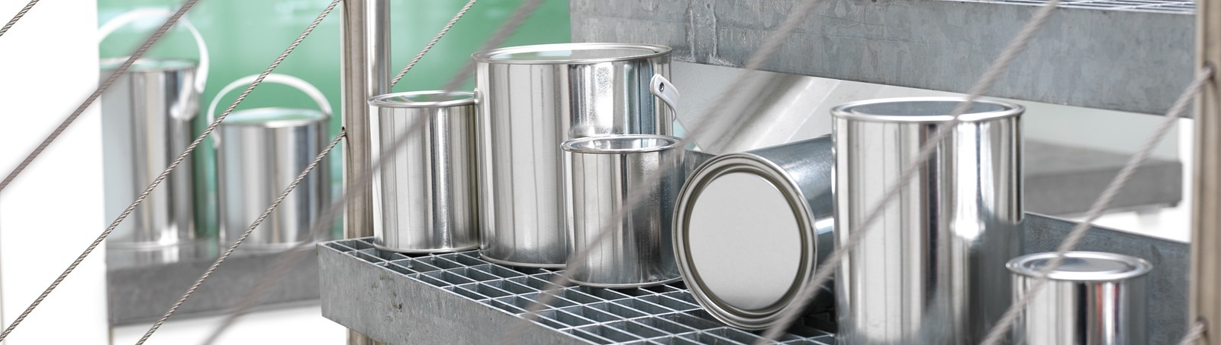

General Line
Notes:
.
General Line

Slide 33
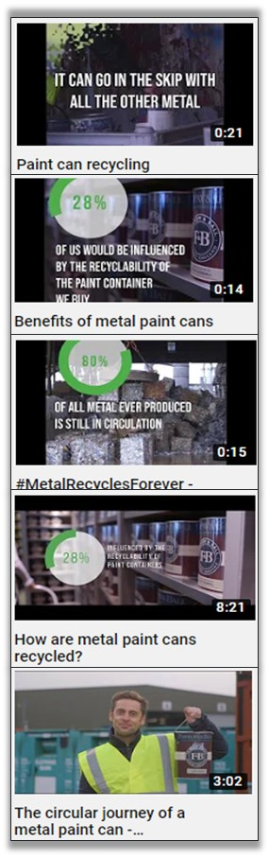
General Line Sector Committee
Committee continues to be an active and well supported committee, its last meeting being held on the 11th March 2020 at which the latest Whittle sector statistics for the second half of 2019 were shared
Statistics
The key points for 2nd half 2019 being:
A poor 2nd half 2019 for containers, but given the good 1st half 2019 results the overall annual sales were not too bad
Container sales -8.8% in 2nd half 2019
Other packaging products -1.5%
Closures +4.2%
In annual terms:
  Containers -2%
  Other packaging products +3%
  Closures +3%
Notes:
2018/19 €30,000 MPE funded UK project – strong social media results and good reusable collateral for future use.
No confirmed results of plastic to metal substitution, but optimistic outlook, given market mood towards plastic.
Ardagh (now Trvium) video is publicly entering the debate.
Surfex 2020 will continue to promote.
MPE General Line WG will support with ‘Circular Economy Sales Person Tool Kit’ in 2020 – funding requested to produce a 24pp booklet to educate retailers/customers (to be used at Surfex)
UK GL member invited to join this European WG – contact Matt

Slide 34
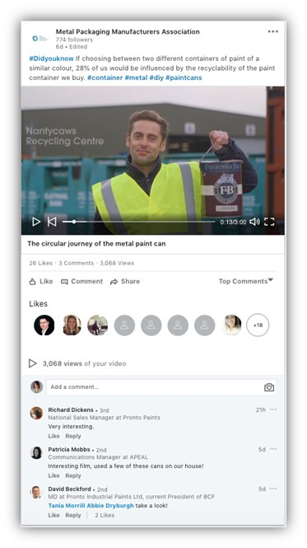
General Line Sector Committee
Summary for Containers:
  3 piece industrial -20% in 2nd half 2019
  Food & other sales unchanged +0.3%
  3 piece slip lids -9%
  2 piece cans -11%
  Poor year for exports
  Closures 20% but 2 piece cans -16%
  Employee numbers down 8% in last year
Notes:
Social media results for Phase 1 (2 minute video):
Twitter received 64,258 impressions, 29,488 video views, 219 completed video views.
Facebook received 57021 impressions, 13,745 video views, 9,166 completed video views.
Linkedin: received 4,011 impressions and 15 clicks.
Social media results for Phase 2 (short 30 second videos):
Twitter received 59,147 impressions, 25,680 video views, 167 completed video views.
Facebook received 63,779 impressions, 34,757 video views, 14,537 completed views.
Linkedin received 5,544 impressions and 16 clicks.

Slide 35

Surfex 2020
As a consequence of the coronavirus SURFEX 2020 has been postponed until the 20th to 21st October
However, preparations will continue to ensure we have all the required resources well in advance of the event
Notes:
Surface & Coating Technology Exhibition & Conference
2nd & 3rd June 2020, Ricoh Arena, Coventry
Low cost - contra-deal agreed
Stand adjacent to the BCF stand
1 hour presentation slot on day one

Slide 36
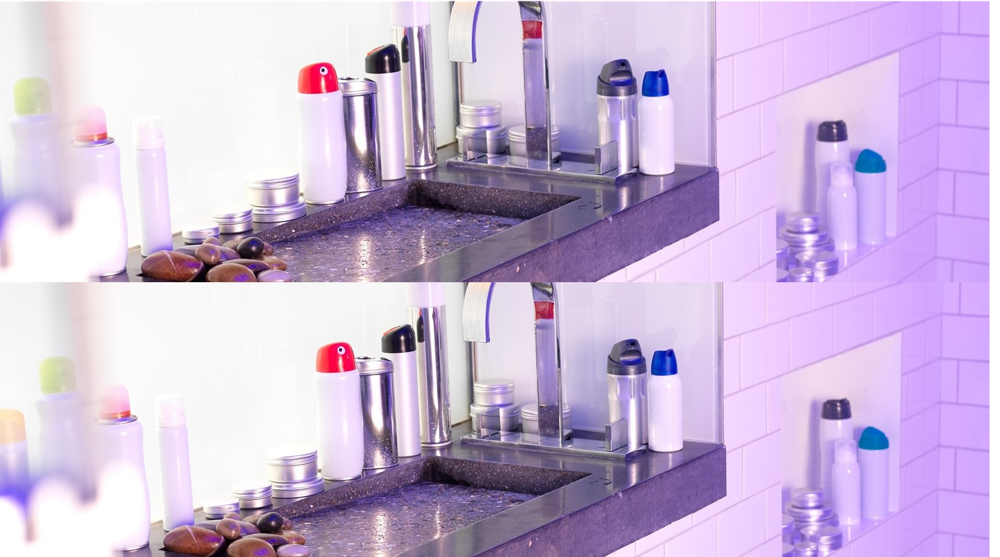
Aerosols
Notes:
Aerosols

Slide 37
Aerosols Working Group
Aerosol Working Group continues to struggle with a low level of member engagement.
Last meeting remains 5th December 2018. However, aerosol issues are starting to grow and so every effort will be made to reinvigorate the working group
One issues is the shift in focus from single use plastics to single use packaging. Aerosols are potentially at risk given that by definition an aerosol is a single trip container.
BAMA continues to support a refillable aerosols project as a defensive measure against the potential criticism of “single trip”
In addition, the continued interest from BAMA’s filling members in plastic aerosols means that BAMA as an Association is having to remain material neutral and so is unable to promote the benefits of metal aerosols
Finally, and most worryingly, Kensington & Chelsea MRF (Riverside MRF) has recently stopped taking aerosols due to claims of a fire risk. This has probably been influenced by the hard line being taken by the Environment Agency with regard to waste site fires
However, it’s critically important that this approach does not spread given that the labelling schemes for packaging are currently being updated by OPRL have just updated their on-pack labelling scheme
Notes:
Previous meeting remains 05/12/18. The attendance was limited.
Since then the Chair, Mark Ward, Crown Holdings has retired and no replacement has currently been identified.
The next planned meeting, 11/09/19 had to be cancelled due to lack of attendees
BAMA continues to support a Refillable Aerosols project as a defensive measure against the potential criticism of “single trip”
The continued interest from BAMA’s filling members in plastic aerosols means that BAMA as an Association is having to remain material neutral
The Working Group needs re-energising especially in light of renewed risks from a range of directions.

Slide 38
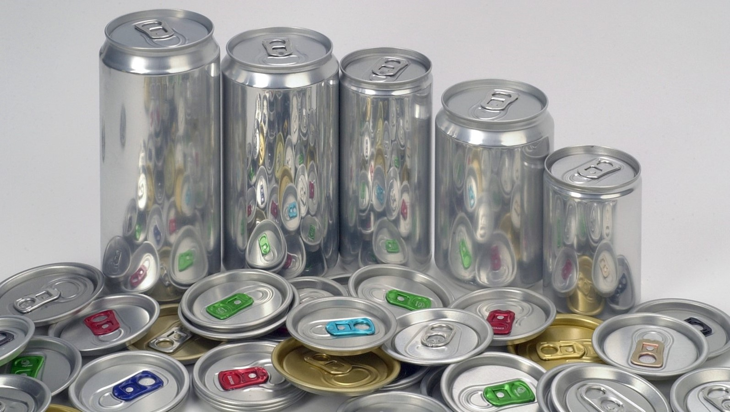
Beverage
Notes:
Beverage

Slide 39
Can Makers Committee
Can Makers committee changed their PR agency in January from Allison & Partners to the Manchester based Pelican.
Working very well with Pelican already making good progress in several areas
Can Makers continues to work closely with both MPMA and Alupro and as previously reported all three groups sent a joint letter to the Scottish First Minister with regard to concerns over their DRS scheme
It has been agreed that Pelican and Twelve PR (MPMA’s PR agency) will exchange information and share each other’s social media to maximise the reach and benefit from each organisations PR.
To this end, Graham Smith from Twelve PR and Michael Bennet from Pelican have each been invited to attend the others PR meeting
Notes:
MPMA proposed merger of Can Makers UK into the MPMA now complete and working well. As planned Can Makers being run as a separate Committee with its own budget.
Can Makers continue to work closely with Alupro, particularly with regard to DRS in Scotland
Carried out consumer research on the recyclability of cans and the Metal Recycles Forever logo
Very strong results obtained in favour of the clarity of the Metal Recycled Forever logo.
Can Makers currently in the process of changing their PR company following concerns over value for money and a lack of a proactive approach from Allison & Partners.
Final 2 candidates are Pelican & Prova
New agency should be in place by end January 2020

Slide 40
Can Makers Committee
Can Makers is also looking at its source of market data.
For some years the committee purchased beverage market data from Nielsen, however their 2020 quote was 25% higher than previous years and also included further restrictions on how the supplied data could be used
The committee is currently finalising a quote from Kantar with the help of Graham Smith from Twelve PR
One of the areas currently being developed is a blind taste test challenge looking at wine in cans.
There has already been some extremely positive feedback from the press / influencer outreach, with both the editor of Decanter and the wine and spirit specialist at Good Housekeeping expressing a keen interest in attending the event.
Clearly, this will have to be delayed until after the lock-down is lifted, but the response has been very positive
Notes:
MPMA proposed merger of Can Makers UK into the MPMA now complete and working well. As planned Can Makers being run as a separate Committee with its own budget.
Can Makers continue to work closely with Alupro, particularly with regard to DRS in Scotland
Carried out consumer research on the recyclability of cans and the Metal Recycles Forever logo
Very strong results obtained in favour of the clarity of the Metal Recycled Forever logo.
Can Makers currently in the process of changing their PR company following concerns over value for money and a lack of a proactive approach from Allison & Partners.
Final 2 candidates are Pelican & Prova
New agency should be in place by end January 2020

Slide 41
8. Officers and Councillors
List of Councillors to be ratified at AGM:
Mr R Arratia, Ball Packaging
Mr M Arsand, Ball Packaging
Mr T Conybeare, Crown Bevcan
Mr G Courtney, Huber Packaging
Mr G Dibb, Emballator Packaging
Mr P Fisher, Can-Pack UK
Mr S Gresty, Ardagh Metal Beverage
Mr L Healey, Trivium - Norwich
Mr D Horton, Trivium - Sutton
Mr Robert-Jan ter Morsche, Ardagh Metal Beverage - (Norman Lett permanent deputy)
Mr R O’Neill, Tinmasters
Mr J Powell, JKP Tins
Mr A Ruddock, Crown Food
Mr C Saunders, Roberts Metal Packaging
Mr A Ward, William Say & Co
Mr P Wilkinson, William Say & Co
Chairman: Aidan Ruddock
Deputy Chairman: Jason Powell
Honorary Treasurer: Chris Saunders
Notes:
MPMA proposed merger of Can Makers UK into the MPMA now complete and working well. As planned Can Makers being run as a separate Committee with its own budget.
Can Makers continue to work closely with Alupro, particularly with regard to DRS in Scotland
Carried out consumer research on the recyclability of cans and the Metal Recycles Forever logo
Very strong results obtained in favour of the clarity of the Metal Recycled Forever logo.
Can Makers currently in the process of changing their PR company following concerns over value for money and a lack of a proactive approach from Allison & Partners.
Final 2 candidates are Pelican & Prova
New agency should be in place by end January 2020

Slide 42

9. Metal Packaging Europe
MPMA continues to engage with MPE and to attend and contribute to their committees.
MPE activity in the areas of food contact and environment in particular remain valuable, but the concern is that with the potential for greater legislative divergence following BREXIT the value of this interaction could start to reduce over time
MPE have started two new working groups:
  Competing Materials WG related to dealing with the threat from competing materials, and the
  SUPD Working group related to defending our exclusion from the EU’s Single Use Plastics Directive. The background being that the European Carton Makers Association are trying to get cans put into scope of the directive because of the can linings and plastic re-closable ends.
We are actively involved in both working groups

Slide 43
Metal Packaging Europe
Metal Recycles Forever logo is going from strength to strength and as a consequence there have been cases of misuse.
MPE is therefore looking at registering the logo in multiple countries
Staffing situation at MPE continues to change with Ellen Wauters, who having just returned from maternity leave, is now working her notice
This means that there are no original staff left at MPE
MPE have also changed their funding rules such that from 2021 onwards there will be no funding available for any national campaigns.
The first casualty of this change is Metal Matters in the UK the MPE financial support for which has now stopped

Slide 46
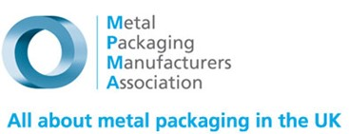














10. Interface with other UK Organisations
Can Makers
Notes:
Interface with other UK Organisations

Slide 47
Interface with other UK Organisations
    MPMA remains part of Make UK. Good level of support received by MPMA
      MPMA’s members can join Make UK FOC as an Associate member – provides benefits
    Relationships being maintained with Packaging Federation, Food & Drink Federation & INCPEN
      Some concerns over high plastics focus – considerable efforts being spent to mitigate current crisis and to try to manage the situation
    MPMA now formally a Guarantor (as are Alupro) of OPRL
    MPMA in discussion with IOM3 to become an Affiliate Member (FOC) – if agreed will provide additional member benefits
Notes:
MPMA will end membership of UK Metals Council at the end of the year
Decision taken end 2018. No evidence to suggest this decision should be reversed
MPMA remains part of Make UK. Good level of support received by MPMA
MPMA’s members can join Make UK FOC as an Associate member – provides benefits
Relationships being maintained with Packaging Federation, Food & Drink Federation & INCPEN
Some concerns over high plastics focus – considerable efforts being spent to mitigate current crisis and to try to manage the situation
Strong relationship continues with Alupro
Relationship being developed with OPRL. MPMA will soon be formally approved as a Guarantor (as are Alupro)
MPMA in discussion with IOM3 to become an Affiliate Member (FOC) – if agreed will provide additional member benefits

Slide 48
Interface with other UK Organisations
Alupro/Metal Matters
Although our relationship with Alupro remains strong, an issue has arisen as a consequence of MPE’s decision to stop their funding of Metal Matters in 2020 that the Council need to take a decision on.
The decision by MPE reduced Metal Matters budget by £30,000 and the Alupro Strategy Committee decided at their last meeting that MPMA should be asked to make up the majority of the difference.
The email detailing the Alupro Strategy Committee view is attached for discussion.
Notes:
MPMA will end membership of UK Metals Council at the end of the year
Decision taken end 2018. No evidence to suggest this decision should be reversed
MPMA remains part of Make UK. Good level of support received by MPMA
MPMA’s members can join Make UK FOC as an Associate member – provides benefits
Relationships being maintained with Packaging Federation, Food & Drink Federation & INCPEN
Some concerns over high plastics focus – considerable efforts being spent to mitigate current crisis and to try to manage the situation
Strong relationship continues with Alupro
Relationship being developed with OPRL. MPMA will soon be formally approved as a Guarantor (as are Alupro)
MPMA in discussion with IOM3 to become an Affiliate Member (FOC) – if agreed will provide additional member benefits

Slide 49
Interface with other UK Organisations
Alupro/Metal Matters
Hi Robert
Last week we held a meeting of the Alupro Strategy Committee and we discussed again the financial contributions to the MetalMatters programme.
I shared with the group the detail of the conversation we had before Christmas. I explained that you and your members are very supportive of the MetalMatters programme and recognise its importance, but right now you have pressures on your budget which do not allow you to increase your contribution up to the level previously contributed by MPE on behalf of the wider metal packaging sector.
The Alupro Board is very clear that the MetalMatters programme is a “metal packaging” programme which encourages the recycling of all formats of aluminium and tinplate packaging. It therefore believes that it is reasonable to expect all beneficiaries of the programme to contribute to the costs on a fair and equitable basis. That being said, it recognises MPMA’s current budget constraints and proposes the following funding compromise:
MPMA doubles it’s financial contribution to the programme each year for the next 3 years, as follows:
2019 £2,500 2021 £10,000
2020 £5,000 2022 £20,000
I have been asked to share this proposal with you and request that you ensure it is discussed by your Board at the next Board meeting.
I am optimistic that we can find a sensible way through this.
Happy to chat this through if it would be useful.
Kind regards
Rick
Notes:
MPMA will end membership of UK Metals Council at the end of the year
Decision taken end 2018. No evidence to suggest this decision should be reversed
MPMA remains part of Make UK. Good level of support received by MPMA
MPMA’s members can join Make UK FOC as an Associate member – provides benefits
Relationships being maintained with Packaging Federation, Food & Drink Federation & INCPEN
Some concerns over high plastics focus – considerable efforts being spent to mitigate current crisis and to try to manage the situation
Strong relationship continues with Alupro
Relationship being developed with OPRL. MPMA will soon be formally approved as a Guarantor (as are Alupro)
MPMA in discussion with IOM3 to become an Affiliate Member (FOC) – if agreed will provide additional member benefits

Slide 50
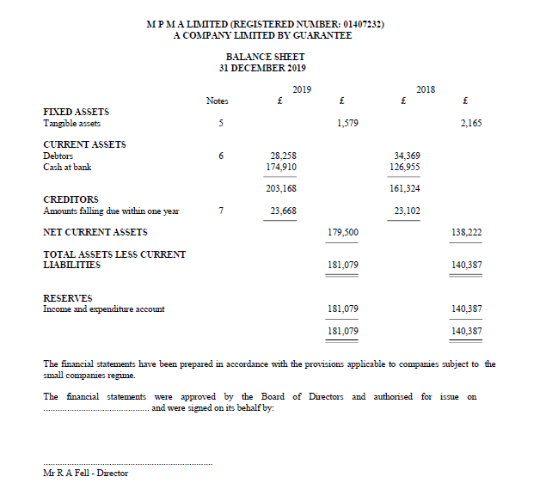
11. Finance
Notes:
MPMA will end membership of UK Metals Council at the end of the year
Decision taken end 2018. No evidence to suggest this decision should be reversed
MPMA remains part of Make UK. Good level of support received by MPMA
MPMA’s members can join Make UK FOC as an Associate member – provides benefits
Relationships being maintained with Packaging Federation, Food & Drink Federation & INCPEN
Some concerns over high plastics focus – considerable efforts being spent to mitigate current crisis and to try to manage the situation
Strong relationship continues with Alupro
Relationship being developed with OPRL. MPMA will soon be formally approved as a Guarantor (as are Alupro)
MPMA in discussion with IOM3 to become an Affiliate Member (FOC) – if agreed will provide additional member benefits

Slide 51
Finance
Notes:
MPMA will end membership of UK Metals Council at the end of the year
Decision taken end 2018. No evidence to suggest this decision should be reversed
MPMA remains part of Make UK. Good level of support received by MPMA
MPMA’s members can join Make UK FOC as an Associate member – provides benefits
Relationships being maintained with Packaging Federation, Food & Drink Federation & INCPEN
Some concerns over high plastics focus – considerable efforts being spent to mitigate current crisis and to try to manage the situation
Strong relationship continues with Alupro
Relationship being developed with OPRL. MPMA will soon be formally approved as a Guarantor (as are Alupro)
MPMA in discussion with IOM3 to become an Affiliate Member (FOC) – if agreed will provide additional member benefits

Slide 52

12. Any other business
Notes:
MPMA will end membership of UK Metals Council at the end of the year
Decision taken end 2018. No evidence to suggest this decision should be reversed
MPMA remains part of Make UK. Good level of support received by MPMA
MPMA’s members can join Make UK FOC as an Associate member – provides benefits
Relationships being maintained with Packaging Federation, Food & Drink Federation & INCPEN
Some concerns over high plastics focus – considerable efforts being spent to mitigate current crisis and to try to manage the situation
Strong relationship continues with Alupro
Relationship being developed with OPRL. MPMA will soon be formally approved as a Guarantor (as are Alupro)
MPMA in discussion with IOM3 to become an Affiliate Member (FOC) – if agreed will provide additional member benefits

Slide 53

13. Date and Venue of next meeting
Wednesday 18th November ?
or
Thursday 19th November ?
or
Tuesday 24th November ?
or
Wednesday 25th November ?
or
Thursday 26th November ?
In person or on-line to be decided nearer the time ?
Notes:
MPMA will end membership of UK Metals Council at the end of the year
Decision taken end 2018. No evidence to suggest this decision should be reversed
MPMA remains part of Make UK. Good level of support received by MPMA
MPMA’s members can join Make UK FOC as an Associate member – provides benefits
Relationships being maintained with Packaging Federation, Food & Drink Federation & INCPEN
Some concerns over high plastics focus – considerable efforts being spent to mitigate current crisis and to try to manage the situation
Strong relationship continues with Alupro
Relationship being developed with OPRL. MPMA will soon be formally approved as a Guarantor (as are Alupro)
MPMA in discussion with IOM3 to become an Affiliate Member (FOC) – if agreed will provide additional member benefits

Slide 54
Annual General Meeting
To confirm the minutes of the Annual General Meeting – held on 16 May 2019
To adopt the accounts of the Association for the year ended 31 December 2019
To authorise the Directors to agree the future role of Foxley Kingham, and to agree their remuneration
To ratify the composition of the Officers and Councillors of the Association
Any other business
Notes:
MPMA will end membership of UK Metals Council at the end of the year
Decision taken end 2018. No evidence to suggest this decision should be reversed
MPMA remains part of Make UK. Good level of support received by MPMA
MPMA’s members can join Make UK FOC as an Associate member – provides benefits
Relationships being maintained with Packaging Federation, Food & Drink Federation & INCPEN
Some concerns over high plastics focus – considerable efforts being spent to mitigate current crisis and to try to manage the situation
Strong relationship continues with Alupro
Relationship being developed with OPRL. MPMA will soon be formally approved as a Guarantor (as are Alupro)
MPMA in discussion with IOM3 to become an Affiliate Member (FOC) – if agreed will provide additional member benefits

